Slide 1





INSIGHTS FROM THE STACK OVERFLOW DEVELOPER SURVEY 2019
Cristhian Alexis VARGAS Vertiz
May 20, 2024
https://www.linkedin.com/in/cristhian-vargas-9349282a3/

Slide 2


OUTLINE
Executive Summary
Introduction
Methodology
Results
Visualization – Charts
Dashboard
Discussion
Findings & Implications
Conclusion
Appendix

Slide 3

EXECUTIVE SUMMARY
Context
Our organization regularly analyzes data to help identify future skill requirements.
Goal
Our organization's primary objective is to keep pace with changing technologies and remain competitive.
Methodology
Data Collection
Data Wrangling
Exploratory Data Analyst
Data Visualization
Results
The most commonly used programming languages, databases, platforms, and web frameworks, as well as those most in demand for the upcoming year.
Discussions
Questions about results.
Final Conclusion

Slide 4

INTRODUCTION
Stack Overflow’s annual Developer Survey is the largest and most comprehensive survey of people who code around the world.
Predictive potential to anticipate shifts in technology and labor market trends within the tech field.
Companies that lead in the development of popular and growing technologies could benefit in terms of competitiveness in the labor and commercial market, and they could remain competitive amid technological changes.
Identifying trends is the first step in the process.

Slide 5

METHODOLOGY
Collect Survey Data
API’s (request library in Python)
Webscraping
Data Wrangling
Dealing with missing values and duplicates
Data Normalization
Exploratory Data Analyst
Analyzing Data Distribution
Handling Outliers Data
Finding Correlation
Data Visualization
Highlight distribution, relationships, composition and comparison of data
Matplotlib & Seaborn
Dashboards
IBM Cognos Analytics

Slide 6
RESULTS
Programming Language Trends – Findings & Implications
Database Trends – Findings & Implications

Slide 7
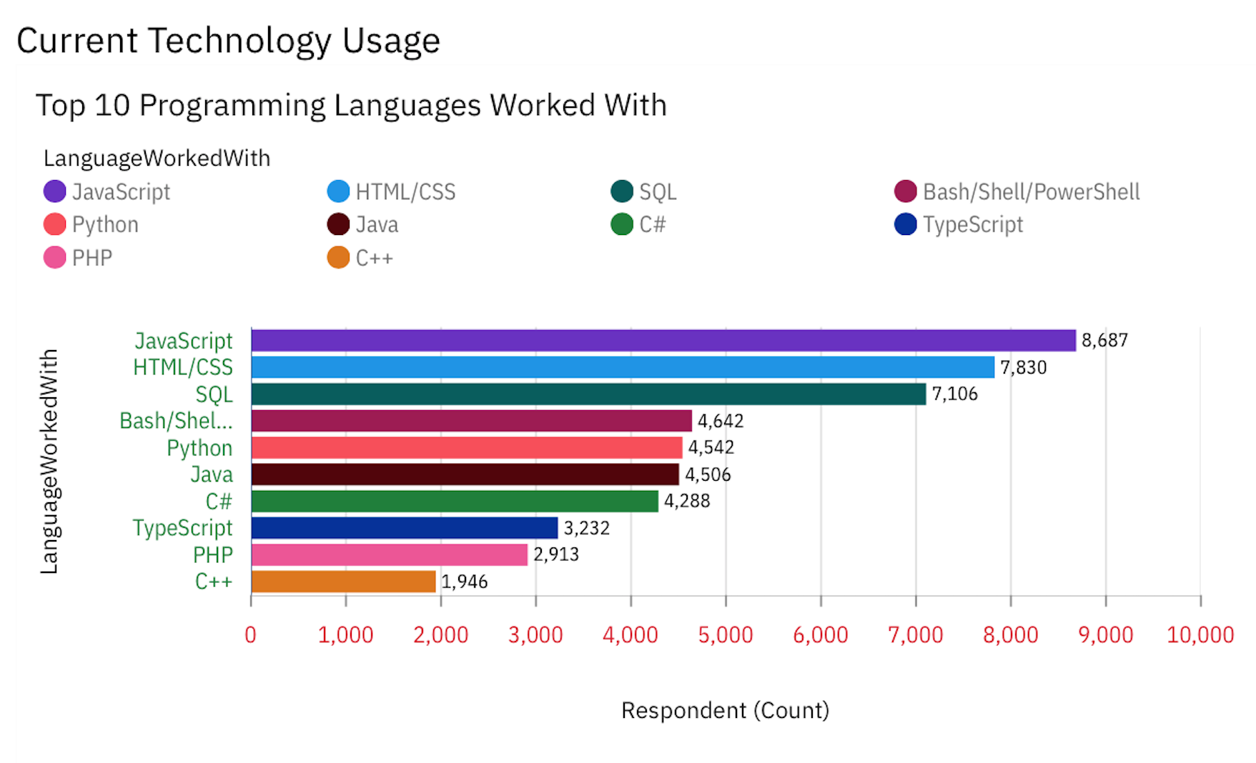
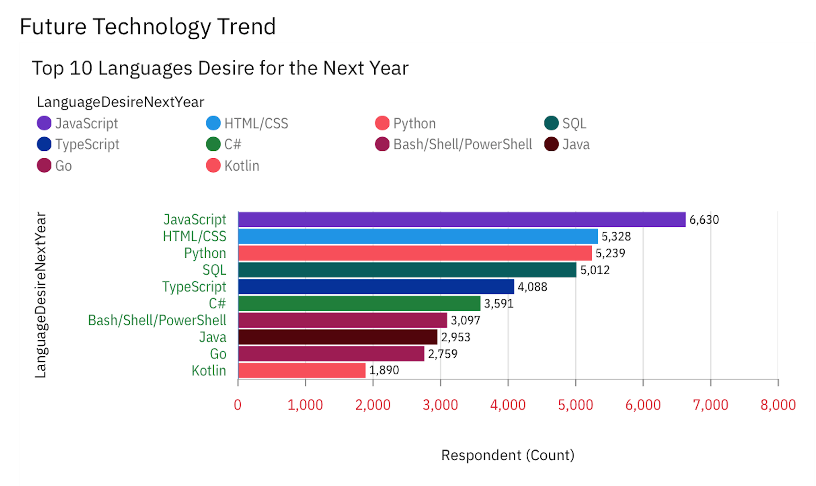
PROGRAMMING LANGUAGE TRENDS
Current Year
Next Year

Slide 8
PROGRAMMING LANGUAGE TRENDS - FINDINGS & IMPLICATIONS
Findings
JavaScript seems to keep as leading Programming Language Trends
Python fastest-growing
Great interest in TypeScript
Less interest in C++, Bash/Shell/PowerShell
Implications
Possible developers migration from others languages to TypeScript.
Python could be leading in the coming years

Slide 9
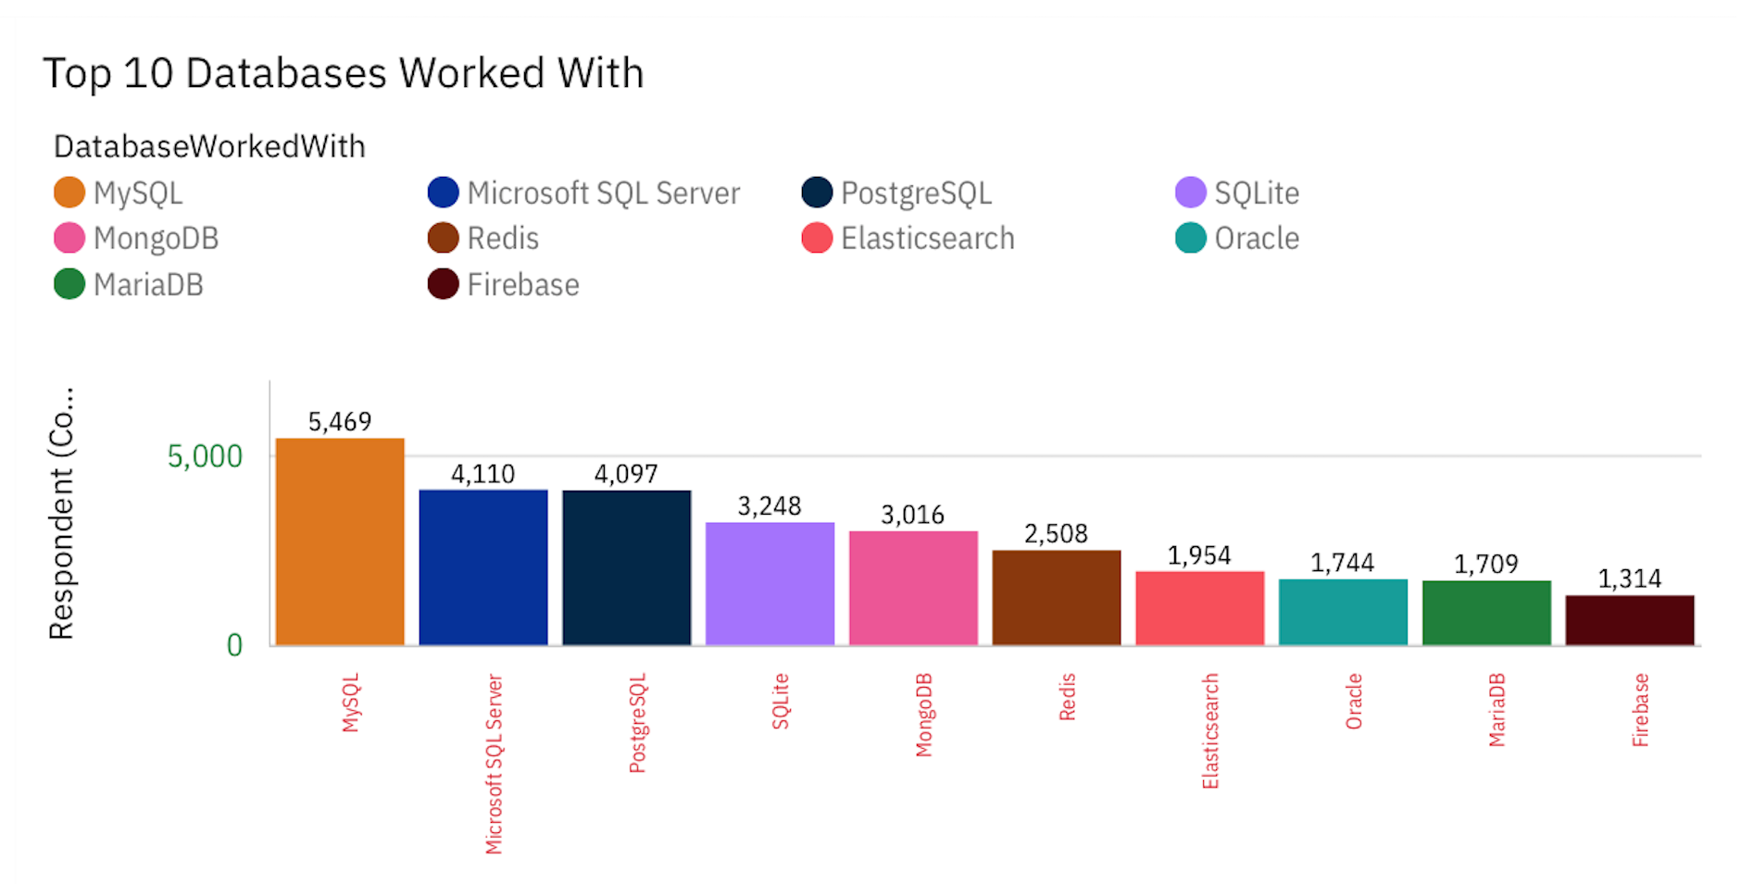
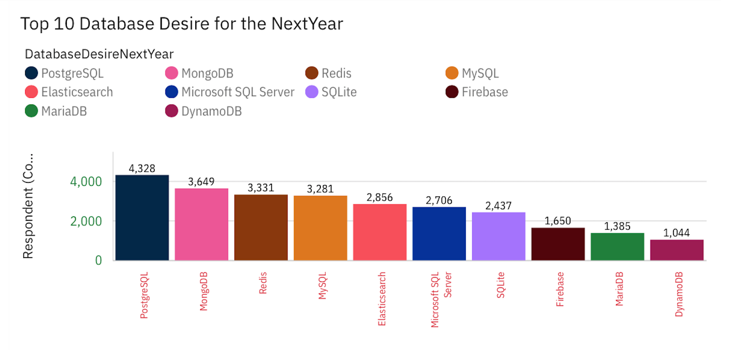
DATABASE TRENDS
Current Year
Next Year

Slide 10
DATABASE TRENDS - FINDINGS & IMPLICATIONS
Findings
Currently, MySQL as most used database.
Less interest in MySQL, Microsoft SQL Server and SQLite.
Great interest in PostgreSQL, MongoDB and Redis.
Implications
The database landscape is highly dynamic.
PostgreSQL, Redis and MongoDB both have positioned themselves well in the market.

Slide 11

DASHBOARD
Link:
< https://github.com/cristhianvargasvertiz/Cristhian-Vargas/blob/main/Dashboard%20IBM%20Cognos.md >

Slide 12
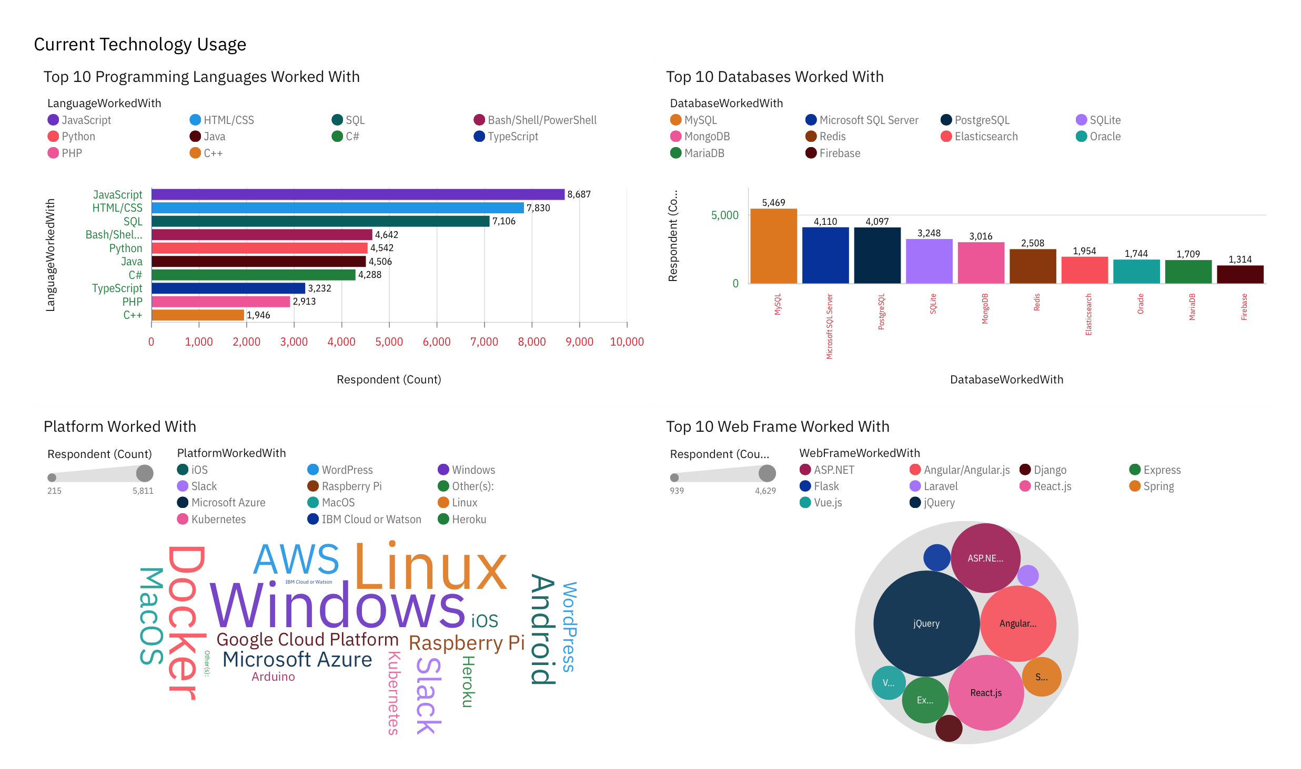
DASHBOARD TAB 1

Slide 13
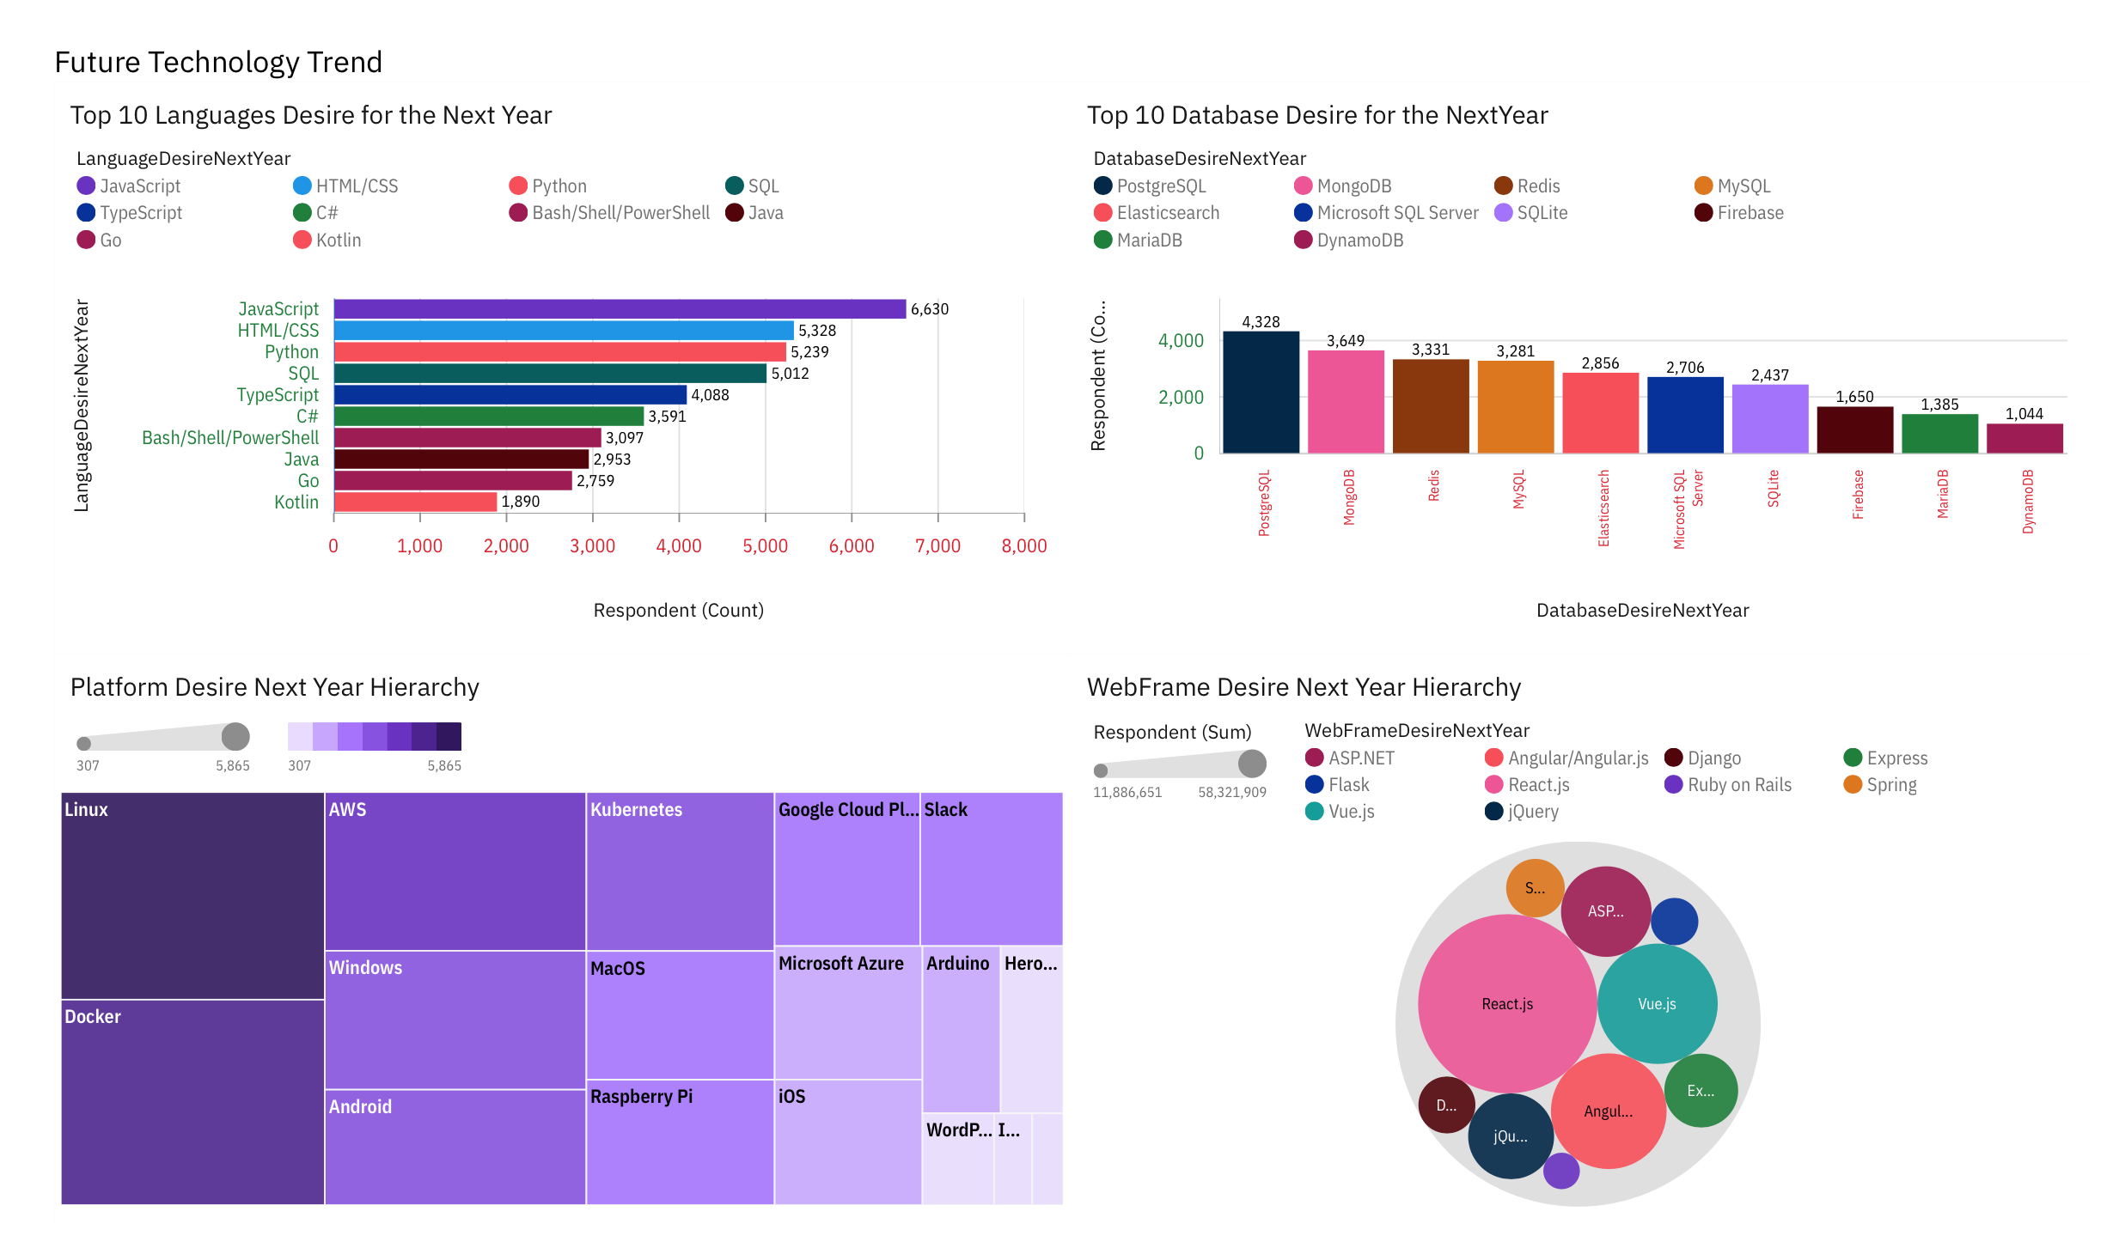
DASHBOARD TAB 2

Slide 14
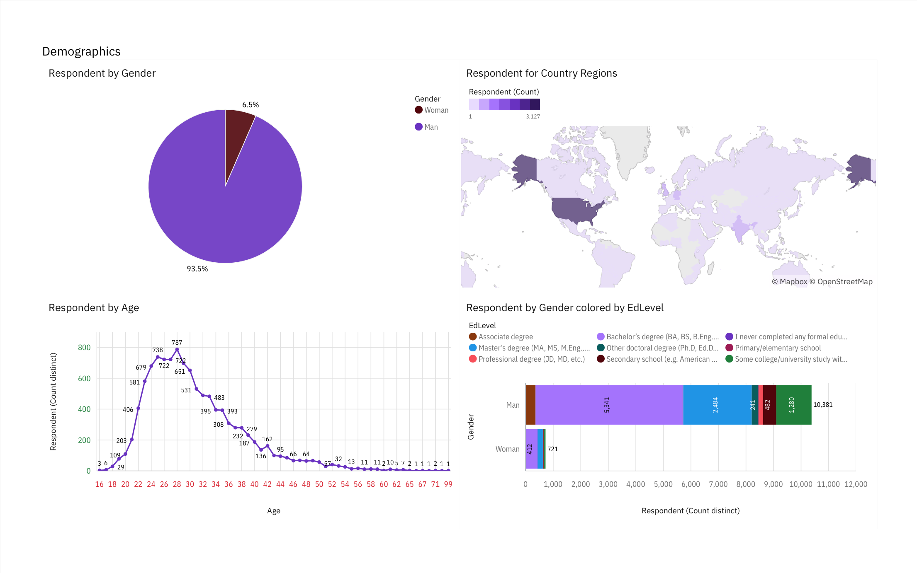
DASHBOARD TAB 3

Slide 15
DISCUSSION
Do you think that programmers need to learn multiple programming languages to remain competitive in the job market, or do you think that one language will always dominate?

Slide 16
OVERALL FINDINGS & IMPLICATIONS
Findings
There is no supremacy between Programming Languages and Databases.
Over 90% young male developers.
Developers mostly located in developed countries.
JavaScript widely used and TypeScript getting popular
Implications
Implies that a single Programming Language or Database dominates the industry.
There is a tendency to develop the industry in the most developed countries.
The masculine gender occupies almost all positions in the job market.

Slide 17

CONCLUSION
Diversity of skills is the key to obtaining a competitive advantage in the industry.

Slide 18

APPENDIX
Include any relevant additional charts, or tables that you may have created during the analysis phase.

Slide 19
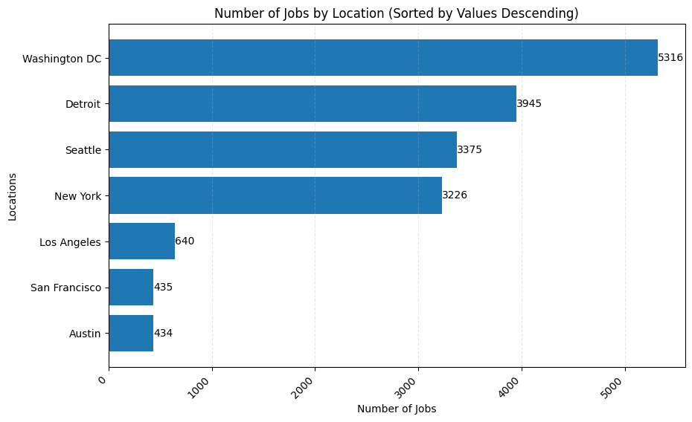
JOB POSTINGS

Slide 20
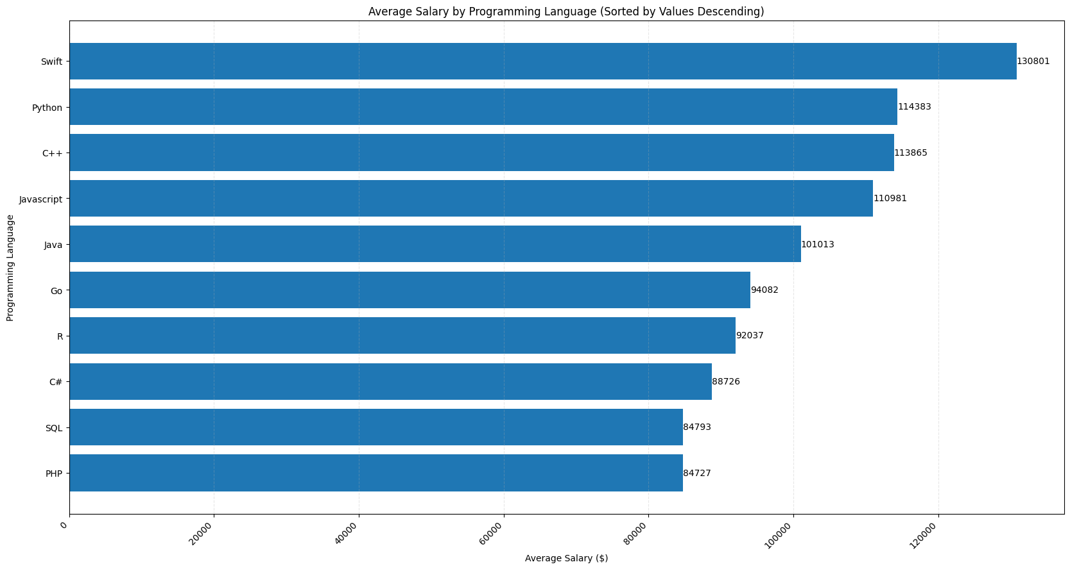
POPULAR LANGUAGES

Slide 21


OBSSESION is going to beat TALENT everytime

